Slide 1
Tag Extractor JGC – Inpex Project Darwin
Jeff Brand – jbrand@adlibsoftware.com
Notes:
Title Slide

Slide 2
The Problem
JGC has an inventory of 165K + Documents and needs to build a tag index relating tags to the documents they are contained in.

Slide 3
The Problem
Some tags are vertically oriented.
Some tag conventions are super-sets of other tag conventions.
Ex: ‘hold’ and ‘withhold’ as search patterns would turn two results in the word ‘withhold’

Slide 4
The Solution
Adlib can take Image and Text-based PDF’s and convert them to Text-PDF using our industry-leading OCR
Adlib can then create an XML file containing all text found in the document

Slide 5
The Solution…Continued
A ‘Helper App’ is employed to create additional copies of PDF, but rotated 90’ left and right to correctly capture vertical text.
Tag Convention patterns defined in Regular Expressions processed with most complex / longest first, then removing matches from XML permit a priority-based tag recognition approach and reduces the chance of duplicate and incorrect matches.

Slide 6
The Solution…Continued
When Adlib PDF is finished with OCR and XML Output, a custom Helper App is launched which searches the XML text records for matches to one or more regular expressions, and inserts all matches into a text report along with this document’s filename, orientation, tag group name and page number tag was found on.

Slide 7
The Solution…Continued
Once a tag report reaches 100MB in size, it is placed in a different folder with a unique filename, and additional records are added to a new report.

Slide 8
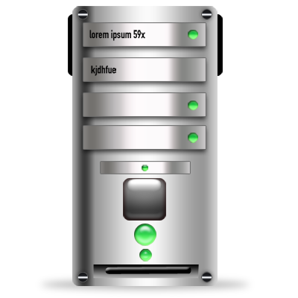


Tag Extractor
Image-PDF and Text-PDF placed in Adlib ‘Input’ folder
A folder ‘Helper App’ creates 2 additional copies of PDF rotated Left and Right to handle vertically-oriented text
Tag Extractor reads each .XML output and identifies matches to configurable Tag patterns (Using RegEx) and saves to a report in TXT format including Document Name, Orientation, Tag, Tag Group, Page #
Adlib OCR’s any non-searchable areas and places .XML including each line of text from each page, one file for each orientation
Once a report esceeds 100MB, the report is moved to a new folder for processing, while a new report begins to accumulate data.

Slide 9

Environment One
Windows Server OS
Environment Two
Windows Desktop OS
4
3
Adlib Input
Input Helper App
2
Reports
5-9
Tag Extractor
1
Temp
Temp
Input
Error
File is placed in Input Folder
Move PDF & rotated copies to Temp
Place XML Job Ticket in Adlib Input to trigger OCR
OCR & place PDFInfo and Searchable PDF in Temp Folder
Read Tag Definitions
Read PDFInfo
Write matches to Tag Definitions to Report
Delete / Copy PDFInfo
Delete / Move Searchable PDF
Output

Slide 10
Tag Extractor
2 Custom Components:
Folder Connector ‘Helper App’ Pre-Processor
Called by Adlib’s Folder Connector, prior to processing a PDF, it will create additional copies of each PDF, one rotated 90’ to the left, and another rotated 90’ to the right in order to successfully capture vertically oriented text.
Folder Connector ‘Helper App’ Post-Processor
Called by Adlib’s Folder Connector, after successful completion of OCR & XML output, Folder Connector will launch the Tag Extractor which will analyze the XML text extraction and populate the tag report.
This component is also responsible for moving the tag report once the file has exceeded 100MB.

Slide 11
Notes:
Q and A Slide

Slide 12







Adlib Software
jbrand@adlibsoftware.com
+61 (03) 5975 6326
+61 (04) 9924 2325
Notes:
Closing Slide

